Slide 1
Lasso Regression
By :-
Bharath Kumar N

Slide 2
Lasso Meaning :-
The word “LASSO” stands for Least Absolute Shrinkage and Selection Operator.
It is a statistical formula for the regularisation of data models and feature selection.

Slide 3
Lasso Regularization Techniques:-
There are two main regularization techniques, namely Ridge Regression and Lasso Regression. They both differ in the way they assign a penalty to the coefficients.
If a regression model uses the L1 Regularization technique, then it is called Lasso Regression. If it used the L2 regularization technique

Slide 4
Lasso Regression :-
Lasso Regression is a type of linear regression that uses L1 regularization.
Regularization is a technique used to combat overfitting in regression models,
and the L1 regularization term adds a penalty to the loss function that encourages the model to have sparse coefficients (i.e. to have some of its coefficients equal to zero).
This results in a simpler and more interpretable model, where only a subset of the features are used in the prediction.

Slide 5
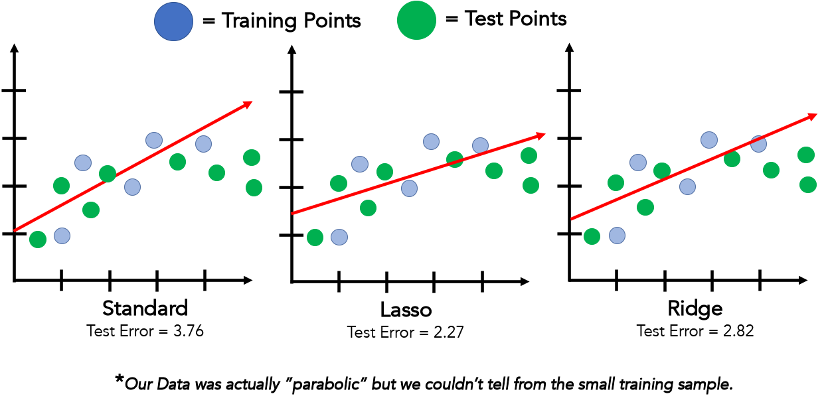
Some Data Points

Slide 6
L1 Regularization
L1 regularization adds a penalty that is equal to the absolute value of the magnitude of the coefficient. This regularization type can result in sparse models with few coefficients.
Some coefficients might become zero and get eliminated from the model. Larger penalties result in coefficient values that are closer to zero (ideal for producing simpler models).

Slide 7
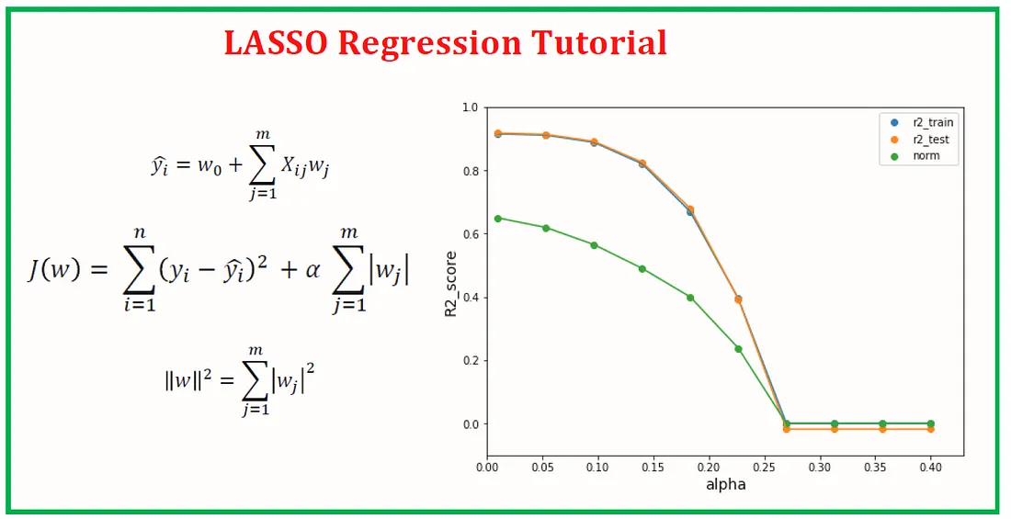

Slide 8
Number of data points
Predicted values
The Penalty Term
Observed values

Slide 9
Lasso Regression is similar to Ridge regression :-
It works by introducing a bias term but instead of squaring the slope (as in Ridge regression) , the absolute value of the slope is added as a penalty term.
Lasso regression helps reduce overfitting and it is particularly useful for feature selection
Lasso regression can be useful if we have several independent variables that are useless
Ridge regression can reduce the slope close to zero (but not exactly zero) but Lasso regression can reduce the slope to be exactly equal to zero.

Slide 10
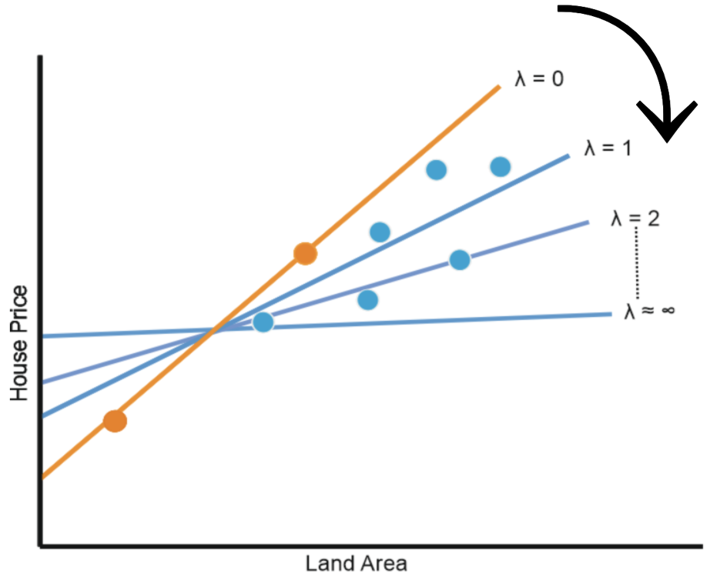




$$α$$
Example of Lasso Regression
$$α$$
The effect of Alpha on Lasso regression is similar to its effect on ridge regression
As Alpha increases, the slope of the regression line is reduced and becomes more horizontal.
As Alpha increases, the model becomes less sensitive to the variations of the independent variable (# Years of experience)
Salary
$$α$$
$$α$$
Experience

Slide 11
Applications of Lasso Regression :-
Feature selection: As Lasso Regression can shrink the magnitude of the coefficients towards zero, it is often used for feature selection in high-dimensional data sets.
Predictive modeling: Lasso Regression can be used as a predictive modeling tool for various types of data, including time-series data, image data, and text data.
Financial forecasting: Lasso Regression can be used for financial forecasting, such as stock price prediction and risk management.
Gene selection: In the field of bioinformatics, Lasso Regression can be used to identify relevant genes in gene expression data.

Slide 12
5. Healthcare: Lasso Regression can be used to identify important risk factors for diseases and to develop predictive models for patient outcomes.
6. Marketing: Lasso Regression can be used to identify the most important predictors of customer behavior and to develop predictive models for customer segmentation and targeting.
7. Sports analytics: Lasso Regression can be used in sports analytics to identify the most important predictors of team or player performance and to develop predictive models for game outcomes.
These are just a few examples of the many applications of Lasso Regression. The technique can be applied to various types of data and in a range of fields where feature selection and predictive modeling are important.

Slide 13
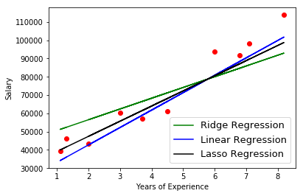

Slide 14
Advantages of Lasso Regression
Feature Selection: One of the biggest advantages of Lasso Regression is that it can be used for feature selection, as the regularization term helps to shrink the coefficients of less important features towards zero, effectively reducing their impact on the model. This can help to avoid overfitting, reduce the complexity of the model, and improve its interpretability.
Handling Multicollinearity: Lasso Regression can handle multicollinearity among features by shrinking the coefficients of less important features towards zero, effectively reducing their impact on the model and reducing the effects of multicollinearity.
Improved Model Interpretability: By shrinking the coefficients of less important features towards zero, Lasso Regression can help to improve the interpretability of the model, as only the most important features are included in the final model.
Robustness: Lasso Regression is robust to the presence of outliers, as the regularization term helps to reduce the influence of any one feature on the model.

Slide 15
5. Efficient Implementation: Lasso Regression can be efficiently implemented using convex optimization algorithms, making it a computationally fast and scalable method for regression.
6. Sparsity: Lasso Regression can produce sparse models, meaning that only a small number of features are included in the final model, making it a good choice for high-dimensional datasets.
7. Flexibility: Lasso Regression can be extended to handle a wide range of regression problems, including linear and non-linear regression, time-series forecasting, image classification, and more.
8. Interpretability: The coefficients in a Lasso model are easier to interpret compared to those in a ridge regression model, because they represent the influence of each feature on the target variable.
Overall, Lasso is a good choice when you want to perform feature selection and reduce the complexity of your model, while still maintaining interpretability

Slide 16
Drawbacks or Limitations of Lasso Regression
Lasso Regression can sometimes exclude important features from the model, reducing its accuracy.
Lasso Regression requires scaling or normalizing the features, which can make the interpretation of the coefficients more difficult.
Lasso Regression can select features that are not strongly related to the target variable, decreasing accuracy.
The optimization problem in Lasso Regression is non-convex, making it difficult to determine the correct solution.
Lasso Regression is limited to linear relationships between the features and the target variable, and may not work well for non-linear regression problems.
The coefficients in a Lasso Regression model can be difficult to interpret, making it hard to determine the relative importance of each feature.

Slide 17
Ways to Prevent the Drawbacks of Lasso Regression
Careful feature selection: Choose features for the model carefully to make sure important features are not excluded.
Fine-tune the regularization parameter: Find the best value for the regularization parameter to balance accuracy and simplicity.
Evaluate model performance: Use metrics to compare the performance of Lasso Regression with other regression techniques.
Consider non-linear regression methods: If the relationship between features and target is non-linear, use other regression methods.
Combine with other models: Consider using Lasso Regression in combination with other regression models to improve performance.
Interpret coefficients: Understand the magnitude and significance of the coefficients to interpret the model's results.

Slide 18
Editing
Lets Build the Lasso Regression :-
Lasso Regression:
Y = wX + b
where, Y --> Dependent Variable
X --> Independent Variable
w --> weight
b --> bias

Slide 19
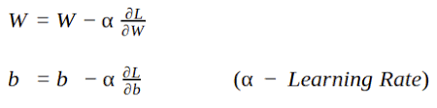
Gradient Descent:
Gradient Descent is an optimization algorithm used for minimizing the loss function in various machine learning algorithms. It is used for updating the parameters of the learning model.
w = w - α*dw
b = b - α*db
Learning Rate:
Learning rate is a tuning parameter in an optimization algorithm that determines the step size at each iteration while moving toward a minimum of a loss function.

Slide 20
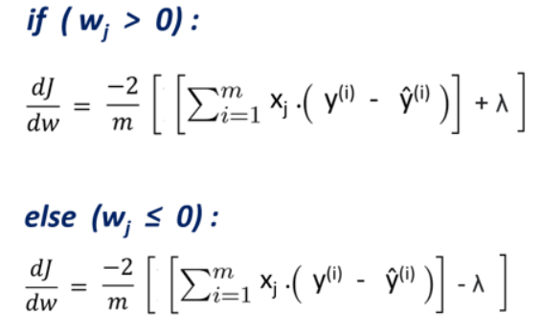
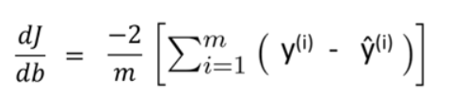
Gradient for Weights Gradient for Bias

Slide 21
Here's how you can implement lasso regression in Python:
Import the necessary libraries
Load the dataset
Pre-processing and Data cleaning
Data Visualization
Checking and treating the outliers
Split the data into training and test sets
Fit the lasso regression model
Predict using the fitted model
Evaluate the model performance

Slide 22
Lets the start the Implementation Of Lasso Regression :-
Importing the Dependencies:-
Lasso Regression is built on linear regression. In linear regression, the goal is to find the line of best fit that minimizes the sum of squared differences between the actual and predicted values. Lasso Regression adds a regularization term to the objective function of linear regression to shrink the coefficients of less important features towards zero, effectively reducing the dimensionality of the model.
import numpy as np

Slide 23
Lasso Regression
creating a class for Lasso Regression
# creating a class for Lasso Regression
class Lasso Regression():
#initiating the hyperparameters
def _init_():
#fitting the dataset to the Lasso Regression model
def fit():
#function for updating the weight & bias value
def update_weights():
# Predicting the Target variable
def predict():

Slide 25
Thank You

